Slide 1
Extended Project:
Data, Data, Data
Visualisation and Presentation of data
Notes:
This session provides some basic pointers that will help you to identify a suitable topic and question for your EP.
Even if you already have a topic in mind, the session will offer you tools to use to refine and focus your theme and the questions you ask – it may also lead you to develop ideas you hadn’t considered yet.
It’s crucial to put some time and energy into this choice in order that you can make the most of project, and hopefully avoid regretting your choice when it’s too late and you’re most of the way through.
You may need to revisit some of the activities after the session, or take more time away to reflect or discuss your ideas with friends or teachers – so don’t feel that you need to have reached any final decisions over the next 40 or so minutes

Slide 2
EPQ and Data
The extended project covers many different formats of projects, for example, a dissertation, performance or field study
This is reflected in the project reporting
In many of these projects, data collection and presentation is necessary or essential!
Good presentation is not necessarily easy
E.g. there are many examples of poor presentation in newspapers and magazines
Notes:
This isn’t just help for the EPQ but is useful for any data presentation large or small.
Data is everywhere and being able to handle and manage it is increasingly important.

Slide 3
Workshop Aims
In this workshop, we will
Set out some simple principles
Assist with clear data and information presentation
Show you how to improve people’s understanding of the data
Show you how to effectively get across the overall message of your dissertation

Slide 4
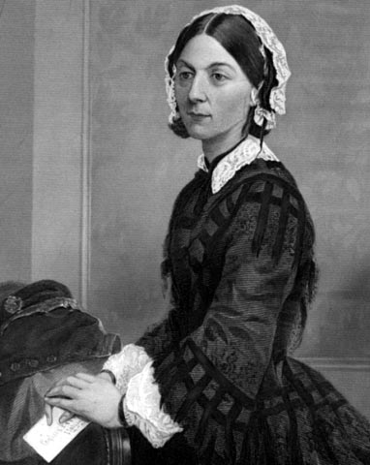
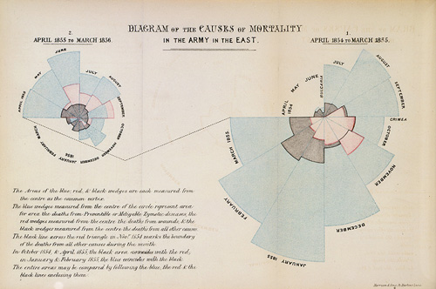
Florence Nightingale and the Crimean War
Polar area charts
Notes:
Classic example of the positive effect of well presented statistics in a novel way
celebrated English nurse, writer and statistician
Florence Nightingale's most famous contribution came during the Crimean War, which became her central focus when reports began to filter back to Britain about the horrific conditions for the wounded. On 21 October 1854, she and a staff of 38 women volunteer nurses, trained by Nightingale were sent to the Ottoman Empire
Florence Nightingale is well known for her selfless nursing of the sick, and her pioneering reform of healthcare. Less well known is that she was also an accomplished statistician! We take a look at some of her finest work.
Florence Nightingale was one of the first to work with polar area charts, or coxcombs, as they are often called.
These graphs are similar to pie charts. The difference is that in a pie chart the wedges each have the same radius, but their angles differ, whereas in a coxcomb, the wedges each have the same angle, but their radii differ. Nightingale used coxcombs to highlight the huge numbers of soldiers who died from diseases during the Crimean War.
Nightingale's 'Coxcombs'

Slide 5
What is Data?
Presenting data
A collection of facts, such as values or measurements
The raw material of science
Contains the information waiting to be released
This is done through data presentation, interpretation and statisitics
What presentation formats are there?
Summary statistics
Tables
Bar charts
Line graphs
Notes:
Data is the raw material that can be used to tell a story.
An investigation with data is like a murder mystery where there is a truth to be uncover.
Data can come in all different shapes and sizes and must be must be understood properly before it can be used effectively.
Maybe think of data as a magic eye puzzle where you just have to look at it the right way to uncover the meaning!
How you present the data will depend on the type of data itself and the message that you want to get across.
These are the three most common ways to present data. The reader should be familiar with these already. They may expect things to be preseented in a certain way and could misinterpret the results if they are presented differently.

Slide 6
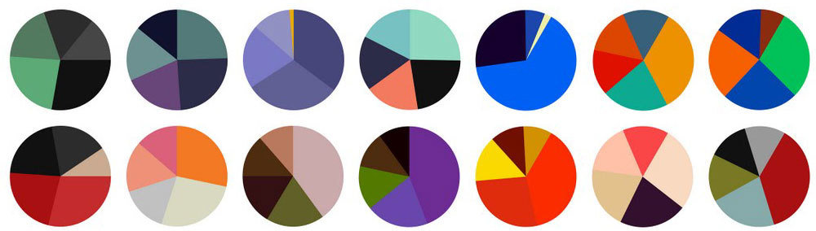
Activity
Spend several minutes in groups coming up with answers to the following:
What different types of data are there?
Can you give some examples of each?
Where do they occur and what are the pros and cons of using them?
Notes:
EXERCISE
Constraints on data may be imposed by the particular context. For example, it may just not be possible to measure something very accurately e.g. recalling things from memory or it may not make sense to give a quantitative value at all e.g. happiness

Slide 7
Types of Data
Qualitative
Descriptive e.g. from a patient interview
Numeric/quantitative
Nominal/Categorical
e.g. male or female
Ordinal
e.g. small, medium, large
Integers, countable, rational
e.g. 1,2,3…
Real, quotients, irrational
E.g. 1/2, 1/3, 1/4…
Notes:
Qualitative data can be observed but not measured. Colours, textures, smells, tastes, appearance, beauty, etc.
This can be more subjective and open to interpretation and an individuals bias.
Example: the report is long and heavy and used Arial font
Quantitative deals with numbers i.e. things that can be measured. Height, length. Weight, volume, etc
Example: the report has 300 pages, is 200g and the height of the letters are 1cm
Data is often divided in to discrete and continuous. In fact most things are discrete because of the accuracy that they can be measured to.
Categorical data doesn’t have a natural ordering to it e.g. which is “better2 men or women?!
Ordinal data is like categorical data but it does have an order
The integers are whole numbers and include the natural numbers (the positive integers)
Haven’t mentioned complex/imaginary numbers since its unlikely they’ll be using these!

Slide 8
Numbers in Text
The general rules are as follows:
Numbers up to and including nine in text should be written in text
i.e. “one”, “two” etc.
Larger numbers should use digits, “11”, “37” etc
Use effectively rounded numbers for up to 10,000; so use “6,200” not “6,248”
For numbers over 10,000 use a mixture of digits and words; “13 thousand” not “13,169”; similarly use “1.1 millions” not “1,148,982”
Often believed most accurate number is better
In fact, this precision implies spurious accuracy and is often misleading

Slide 9
Summary Statistics
Used to summarise a set of observations
in order to communicate the largest amount as simply as possible
Commonly used statistics are:
measure of location, or central tendency
such as the average (mean, median or mode)
measure of spread like the standard deviation
measure of the shape of the distribution like skewness
This can be found by plotting a histogram
if more than one variable is measured, a measure of dependence such as a correlation
Notes:
Skewness is how lob-sided the distribution is, so are most people around a low value and then there are just a few people with much higher values, say.
As well as skewness could mention kurtosis which is how non-bellshaped the distribution is so how much unlike the standard normal distribution.

Slide 10
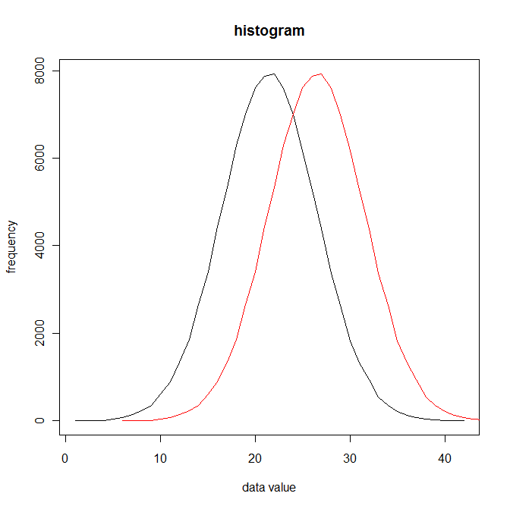
Location
Notes:
The two distributions of the data are the same except for their location on the x-axis. That is, the spread and shape are identical but one set of values is more likely to be larger than the other. This could be girl and boy heights at 14 years old for example.

Slide 11
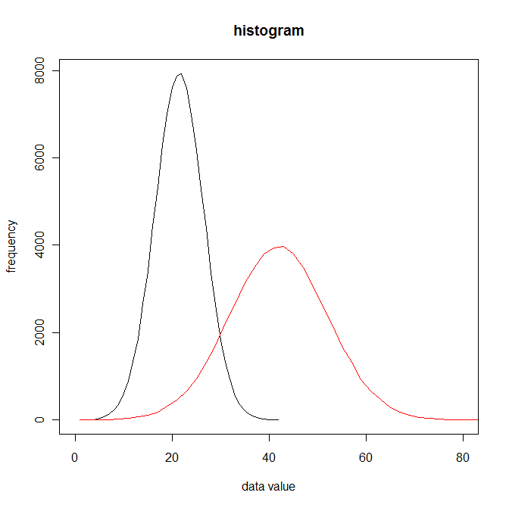
Spread
Notes:
The distribution of the data is now not only in a different place on the x-axis but the spread of the data is different too. That means there is more variability about the red group than the black group.

Slide 12
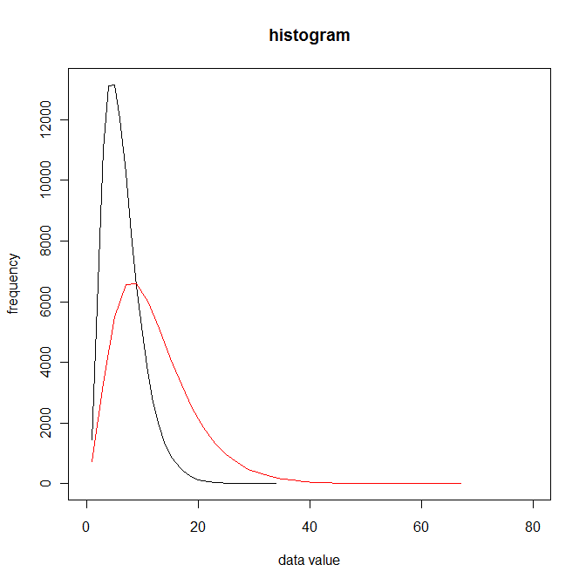
Shape
Notes:
The distribution of the data is now not only in a different place on the x-axis but the spread of the data is different too. That means there is more variability about the red group than the black group.

Slide 13
Things to consider
Consider the following before presenting data figures
Understand
The type of data to be presented
Main feature to be presented: what’s the message?
How this information is used
Who the intended audience is
Tables, charts and diagrams should assist with the interpretation of the data
Be representative of the data
NOT, as frequently occurs, obscuring the meaning of the data
Notes:
Key point is don’t just rush into plotting the figure without thinking first. It can be too easy to simply use Excel without making an active decision what the best thing to do is and why.

Slide 14
Figure Placement
Make sure the size and fonts are large enough to easily read
Reference all the figures in the body of the text
E.g. see Figure 1
Give all Figures appropriate self contained captions
include the figure description and analysis in the body of the text
Consider where best to place the figure
It should be soon after the reference in the text
Notes:
Figures should fit into the story that you’re trying to make with the work and not be cumbersome or a distraction.

Slide 15
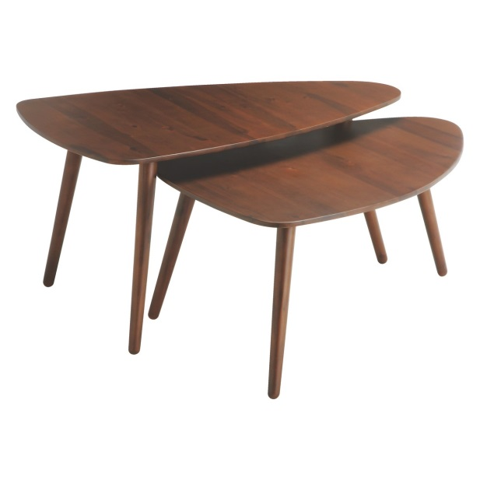
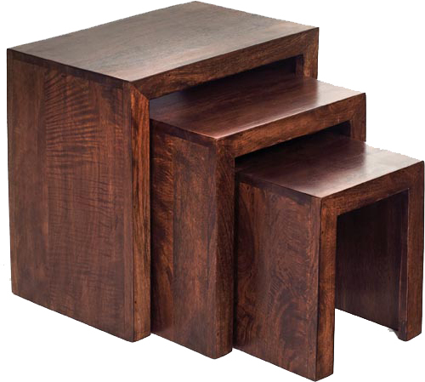
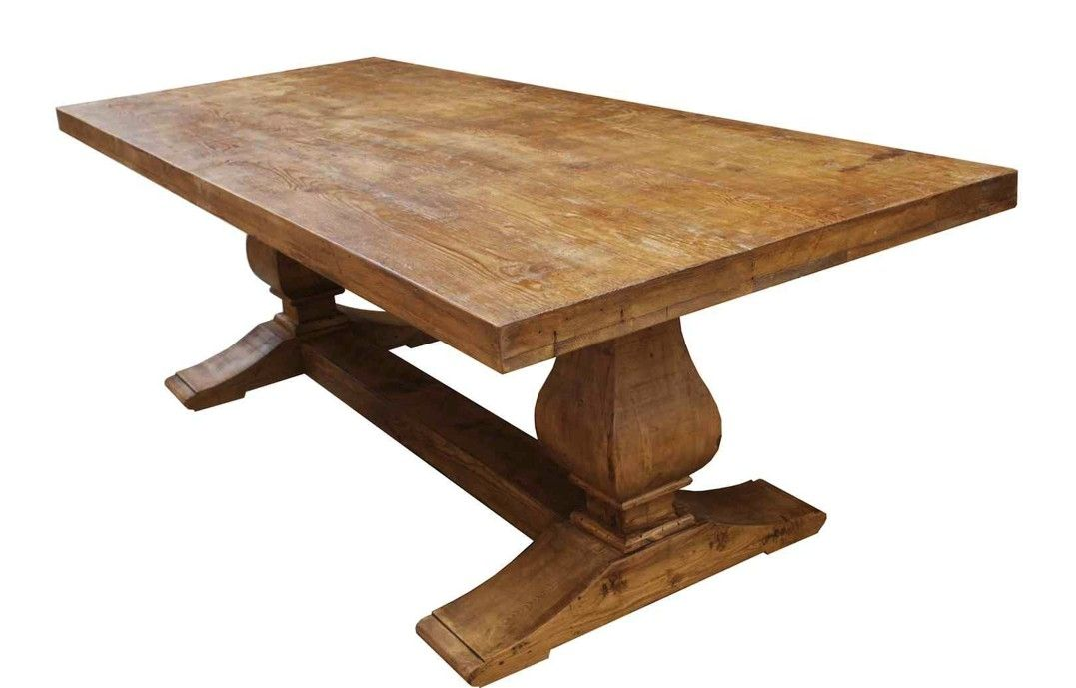
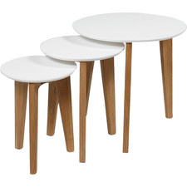
Tables
Notes:
Obviously we’re not talking about dining tables, but over the next few slides we are going to discuss how to present data in tables

Slide 16
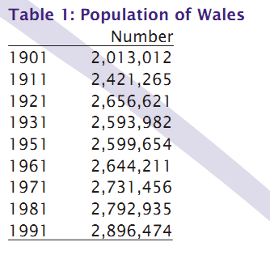
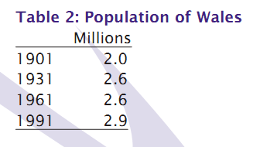
Tables
Presenting all of the actual data is often unnecessary and confusing!
Use tables if
Trend is not important
Number of values are small
To complement other data presentation formats
Examples
Notes:
Consistent formatting is really important with tables.
Table 1 present lots of years and population numbers to a high degree of accuracy. Is this necessary to get the main message across? Is this in fact obscuring the message? Table 2 present fewer results and to 1 decimal place. However, the main trend is now clear through time without including unnecessary detail.

Slide 17
Tables
Style Rules
Principles of Use
Tables should not be filled with grid lines
Sorting
We read from left to right, or top to bottom
Time: from past to present
Increasing size: from small to large
When comparing numbers it is easier to have the numbers in columns than rows
Round data in summary tables
Left/Right justify numbers in columns
Consistent and neat formatting
Time from left to right or top to bottom
Row total at right hand side.
Column totals at bottom
Use space to separate data not lines
Consistent scales and units
Consistent number of decimal places or significant figures
KEEP IT SIMPLE!

Slide 18
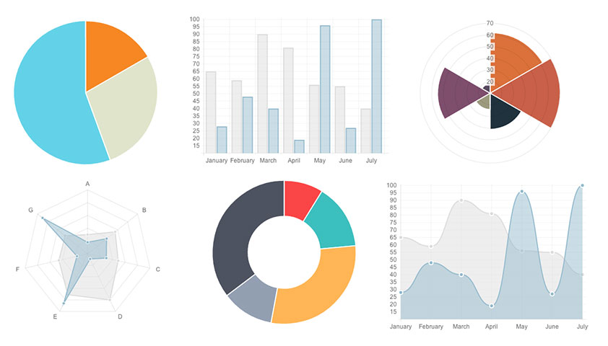
Charts and Graphs

Slide 19
Charts and Graphs
As an alternative to table, these are usually better and easier way to present
Trends
Patterns
large amounts of data
Idea of how things change
Deciding between type of graphs, you need to consider the main questions
What is the aim of the diagram?
Does it meet the aims?
Sounds obvious but people don’t often do this!
Choose the right representation to get your message across
Notes:
We’ll show 5 different representations of the same data. The idea is to discuss what the pros and cons of each approach is and why.

Slide 20
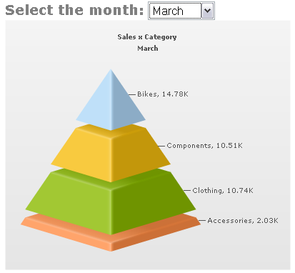
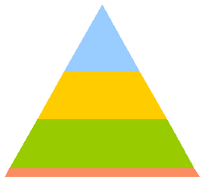
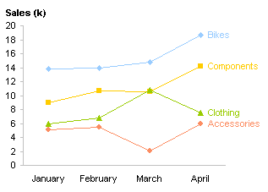
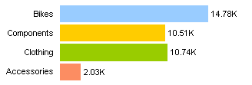
Bike Shop Sales
Notes:
First Diagram
Normally 3D is to be avoided!
Why?
Second Diagram
This is the same data in a 2D format. Do the sizes of the area appear the same as in the 3D plot?
How easy is it to compare the area of different shapes?
e.g. how much bigger is the green area to the blue area?
Third Diagram
This is much clearer (if not a little less exciting) than the 3D pyramid.
Fourth Diagram
The human eye normally reads things from left to right so putting on the side may be more natural.
Placing the bars side-by-side also makes it easier to compare.
Fifth Diagram
Finally, we can include more information in a line graphs. If we want to show change with respect to time this is a common representation.

Slide 21
Activity
How would you present this data?
 | 16-25 | 25-65
The Sun | 348 | 278
The Times | 107 | 167
The Telegraph | 96 | 147
The Guardian | 70 | 99
Newspaper readership figures stratified by age

Slide 22
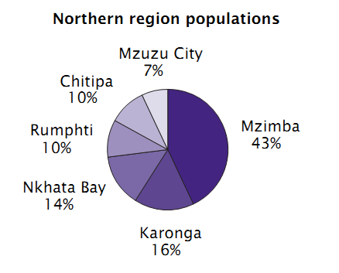
Pie Charts
Represent the proportions of a total amount
It may be easier to read if the segments are ordered by size, from largest to smallest
Don’t use too many (or too few) segments
Group things together if necessary

Slide 23
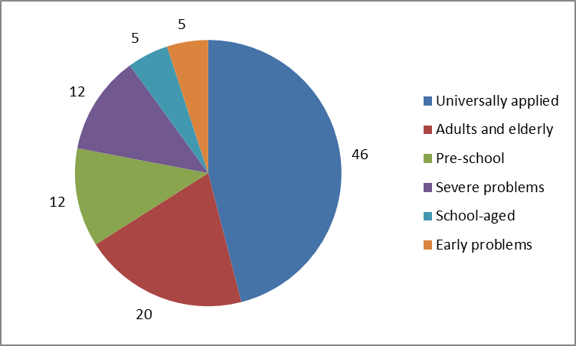
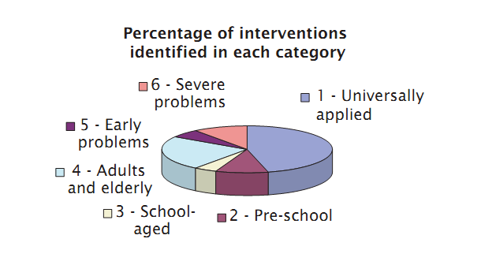
Pie Charts
Is this a good chart?
Notes:
Example 1
Think about the problems with the 3D bar chart. Do these apply for this?
The numbering is deceptive. The numbers from 1 to 6 do not correspond to the size of the areas but rather the degree of severity.
The size of the segments do not go from largest to smallest.
There is no indication of the values of the categories.
Two of the colours used are very similar.
Example 2
This is an example of an improved representation of the data.

Slide 24
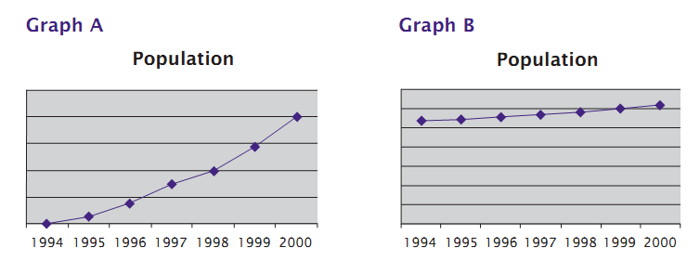
Line Graphs
Normally used to show a change with respect to time
Use a sensible scale
Gridlines can help the eye to navigate the plot
If comparing 2 graphs use the same scale
Use a sensible number of tick points and labelling
Appropriately round the values
ALWAYS label the axis
Notes:
Graphs A and B show the same data. Which is better?
Neither graph gives a y-axis scale or label.

Slide 25
Bar Charts
Represented by area of bars
Show the origin
Do not over-lap areas
When several variables are considered together, what is the important message of the chart?
This will help us think about how to group the bars

Slide 26
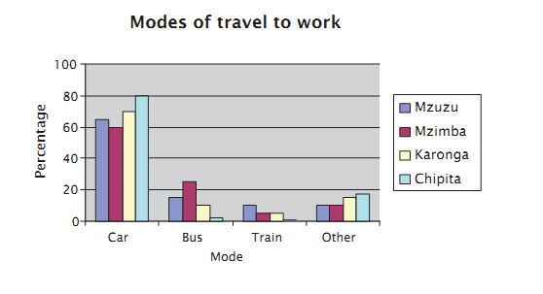
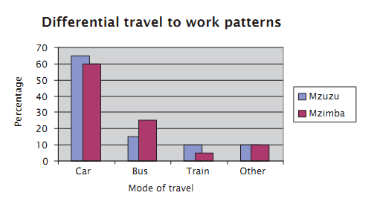
Bar Charts
Are these good bar charts?
Notes:
Some of the same principles we have used to critique the other graphs apply to these.
Which is the best graph?

Slide 27
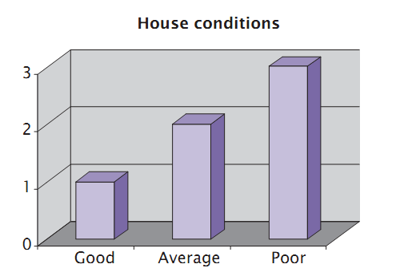
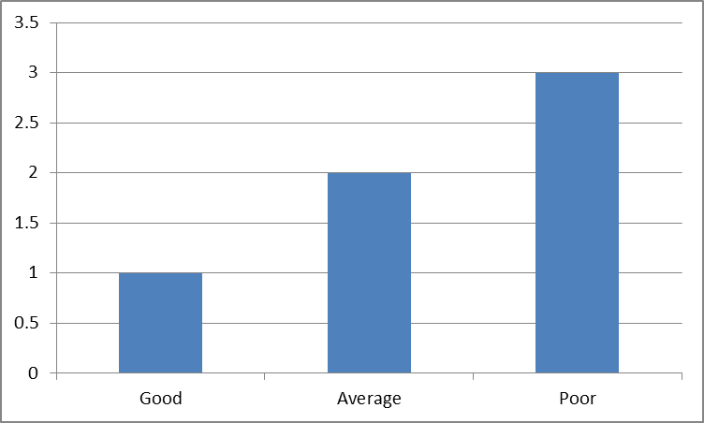
3D Graphs
All three bars appear to be below their scale lines
this is the effect of the third dimension
Area of the front and side faces of the blocks seem to be in the proportion 1, 2 and 3, all have the same top surface
so the first block will appear relatively bigger
The data is represented accurately only in the front face of the blocks
hence that is what should be shown
This graph is much better

Slide 28
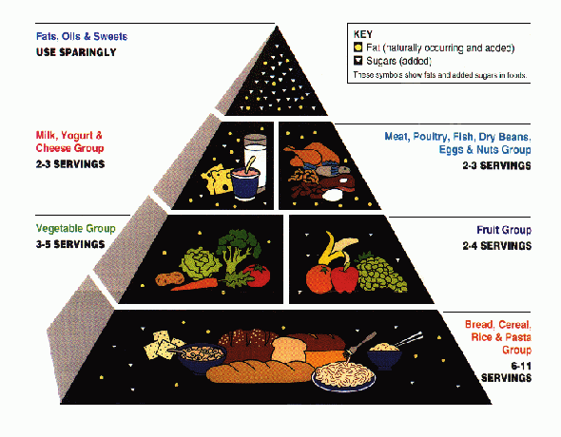
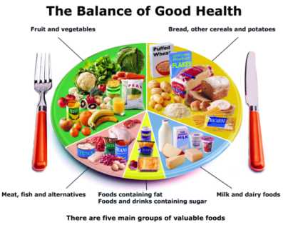
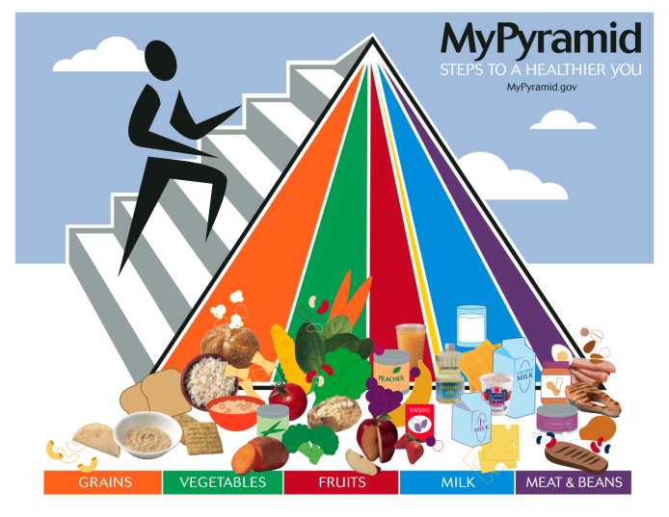
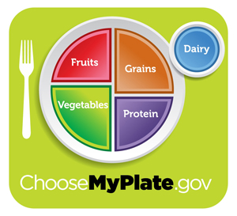
Practise makes perfect
In groups, look at the hand-out and discuss the strength and weaknesses of each representation
decide which of the figures you think is the best and why
Notes:
EXERCISE: There’s a hand-out available to go with this exercise

Slide 29
Further Reading
Information is Beautiful by David McCandless
Exploratory Data Analysis by John W. Tukey (1977)
TED talk Hans Rosling http://www.ted.com/talks/hans_rosling_shows_the_best_stats_you_ve_ever_seen.html

Slide 30
Hand-out figures

